Slide 1
Instacart order Analysis
By: Arpit Bajpai

Slide 2
Background
Instacart is an American company that operates as a sometimes-same-day grocery delivery service.
They released a database on Kaggle and the core focus of it was to determine how likely products were to be reordered.

Slide 3
The Three things we will be examining today are:
1: What are the most poplar products being ordered and reordered?
2: What factors influence one's decision to reorder a good and can we make a model that accurately predicts whether a good will be reordered?
3: By seeing what items a customer is purchasing, can we predict what items they may wish to purchase?

Slide 4
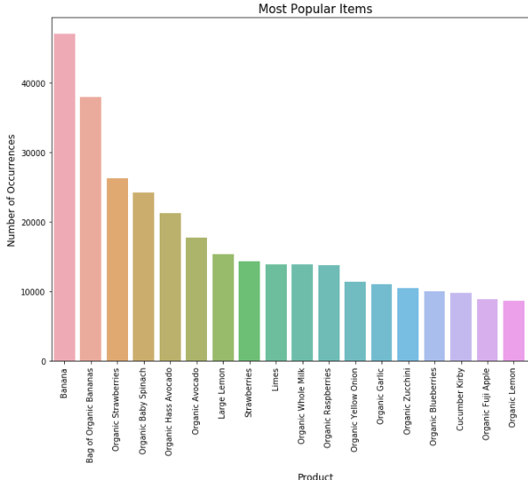
What are the most popular items?
Things we can learn from this:
A significant portion of these products are organic.
People love their bananas!
Almost all the products are some sort of produce.

Slide 5

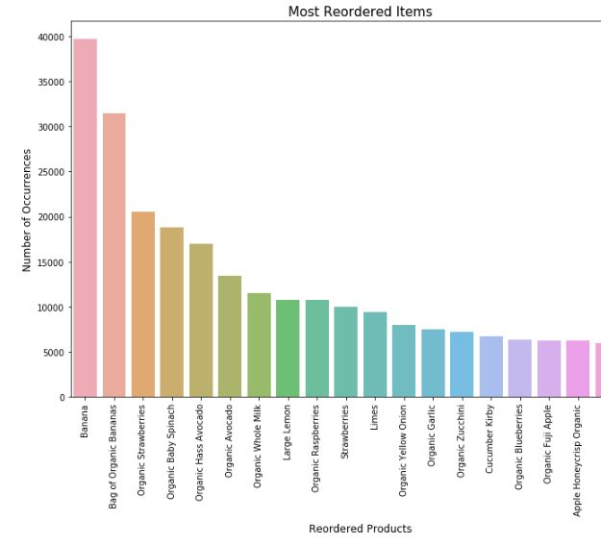

Slide 6
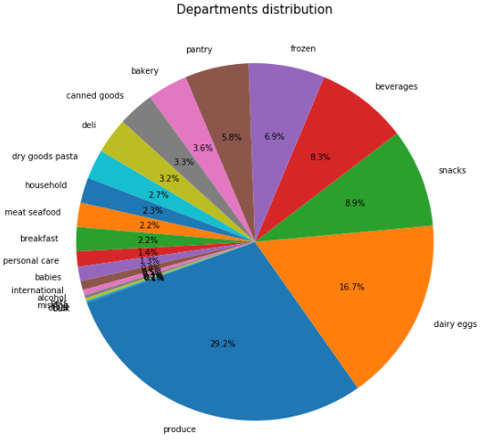
Order Distribution
Dairy and Produce account for nearly half of all orders.
Makes sense considering that they’re the most perishable goods
More specific departments like breakfast were responsible for only a tiny fraction of sales.

Slide 7
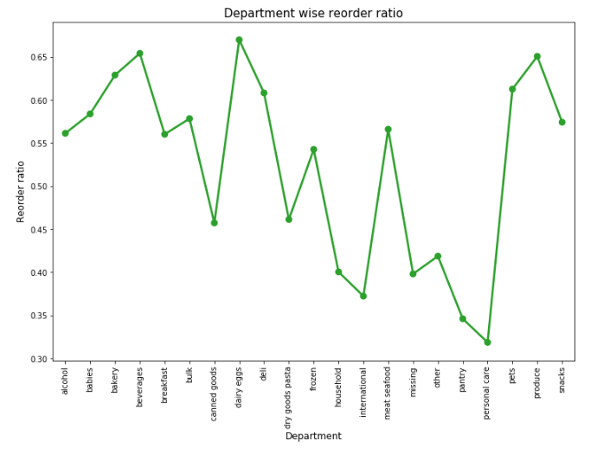

Slide 8
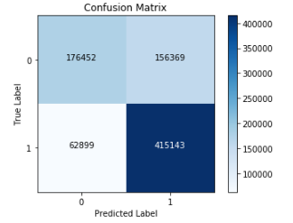
Can we predict whether someone will reorder a product?
The most impactful variables are Department_id, aisle_id, add_to_cart_order, and product_id
We have a predictive model that correctly identifies 72% of all reorders.
The best tool we discovered so far has been using XGBoost, which outperformed Logistic Regression, Decision Tree and Random Forest.
Further improvements may require acquiring additional variables as different techniques offered very modest increases to accuracy.

Slide 9
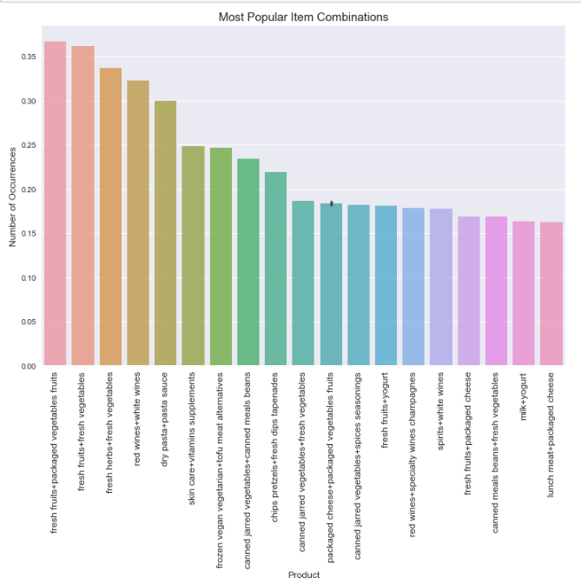
WHAT are the items that have the greatest chance to be purchased together
The biggest winner here is by far fresh produce.
Fresh Fruits and Fresh Vegetables are one of the products that are ordered together very commonly with pretty much every other product or set of products relating to food
A lot of these combinations simply confirm what we already may have suspected.
Someone purchasing from chips pretzels will likely also get something from fresh dips tapenades

Slide 10
Questions to Explore in the future:
Right now we have the capacity to see individual item associations, however I feel that we can take this further in the future as we try to examine the correlation between entire baskets and items.
Additionally, in the future we can look beyond orders and look at users and see if patterns in purchasing behavior can be detected there and personalized recommendations can be made to each user based on the baskets they have purchased in the past.

